Slide 1
3 Pod RNAseq Analysis
9/8/20

Slide 2
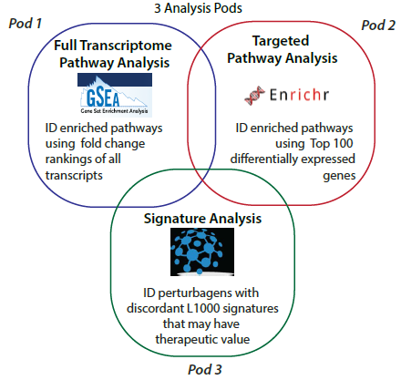
3 Pods
Whole transcriptome pathway analysis
RNAseq
Targeted pathway analysis
Enrichr- top 100 up/down
Perturbagen analysis
iLINCS

Slide 3
Application note
R code
Improve/streamline/add
How far?- DEG input, summarize pathways, leading edge, cell type (via Kaleidoscope), API iLINCS, drug targets (via L1000FWD), compare across pods
Add visuals to better summarize data
Move to R shiny
Benchmarking points
Time/Efficiency
Presentation
Others?
Example dataset?

Slide 4
Other content in workflow?
Common analyses that would be good to have in pipeline format
May or may not be included now
Hunter to condense pathways (end of Pods 1 and 2)
Cell type deconvolution
Bayesian network

Slide 5
Existing R 3 pod pipeline

Slide 6
R script (input)
Done in:
R
Excel
Save CSV with:
Gene log2FC p value
Normalized
Expression
Files
Filter for protein coding genes
Low expression cutoff
Calculate log2FC and p value
Save rnk file:
Gene log2FC (high to low)
Notes:
All manual now but could probably be coded
Extract rnk file from CSV?

Slide 7
R script
Done in:
R
Excel
*output file
Record counts
CSV with:
Gene log2FC p value
Identify up and down regulated genes
log2FC > 0.3 or <-0.3
Get counts for each
1- GSEA
ID counts:
Datasets tested
Positive ES
Negative ES
FDR
Pval < 0.01
Pval < 0.05
**
Reformat for easier
Revigo input
**
rnk file:
Gene log2FC (high to low)
Filter out
Upregulated (p<0.05, +ES)
Downregulated (p<0.05, -ES)
*
Run GSEA
**
Reformat and extract
LE genes
Record counts
Notes:
Plot or get tables for counts?
Revigo API?
Or new way to condense/categorize?

Slide 8
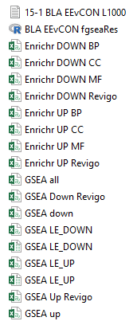
R script
Done in:
R
Excel
*output file
2- Enrichr
CSV with:
Gene log2FC p value
Extract Top 100 Up
and Top 100 Down
******
**
API Enrichr
GO BP, MF, CC
Reformat for easier
Revigo input
3- iLINCS
CSV with:
Gene log2FC p value
*
Extract L1000
So ultimately, current R script runs
analyses but rest (condense pathways,
id similarities, draw conclusions) is manual
Notes:
Same ?s
iLINCS API?

Slide 9
Manual Analysis - GSEA
Done in:
R
Excel
Upregulated (p<0.05, +ES)
Downregulated (p<0.05, -ES)
Reformat for easier
Revigo input
Submit genes/FC
to Revigo
Copy BP, MF, CC tables
and Treeview to Excel
Look across these results to id
Enriched pathways/functional trends
Create pivot table
to count # of times
LE genes appeared
in enriched pathways
Top 20: look up,
compare to pathways,
Kaleidoscope
Reformat and extract
LE genes
Enrichr and Kaleidoscope
To get idea of function
For these key genes
Filter out LE genes with
log2FC >0.3 or <-0.3
Also did this with LE genes
across comparisons/datasets
to see what is consistent
Notes:
LE pathways necessary?
Maybe just look up LE DEGs
Also did similar analysis with genes up in EEvCON
and down in ERvEE (looking for patterns)

Slide 10
Manual Analysis – Enrichr & iLINCS
Done in:
R
Excel
Upregulated (p<0.05)
Downregulated (p<0.05)
Reformat for easier
Revigo input
Submit genes/FC
to Revigo
Copy BP, MF, CC tables
and Treeview to Excel
Look across these results to id
Enriched pathways/functional trends
Copy discordant
perturbagens
to Excel
Look up MOAs on
L1000FWD or internet
if not found
Submit L1000
to iLINCS
Compare MOAs
to pathways
Extract L1000
Copy concordant
perturbagens
to Excel
Look up MOAs on
L1000FWD or internet
if not found
Not really using this
More helpful for EE
Notes:
API L1000FWD?
Other MOA sources?

Slide 11
Other existing code
Combine GO categories
Pathway heatmaps

